Slide 1
Deep Q-Network (DQN) for Traffic Light Control
Authors: Nawaf Salman, Nahel Awidat
Supervisor: Dr. Ayal Taitler
Submission Date: 07/11/2024
Semester: Winter 2023

Slide 2
Outline
Introduction
Problem Statement
Explored Solutions
DQN – Why ?
DQN – High Level
DQN – MDP definition
DQN
DQN – Training Process
Simulation
Results
Conclusion & Future Work

Slide 3
Introduction
Fixed-schedule traffic lights can't adapt to real-time traffic, causing congestion and longer wait times.
Importance of efficient traffic management in modern cities:
- Reduces waiting times
- Minimizes pollution
- Enhances quality of life
Objective: Implement adaptive traffic light control.

Slide 4
Problem Statement
Challenges:
-Reduce waiting times
-prioritize public transport
This requires a dynamic solution that responds to real-time conditions.
Use RL

Slide 5
Explored Solutions
Compared methods:
- Max Pressure:
Dynamic optimization.
Doesn’t consider long-term impact of its decision.
- Actor-Critic Algorithms:
High computation requirement.
Training Requires direct environment interaction.
Chosen: DQN

Slide 6
DQN – Why ?
Learns optimal control strategies over time
Can handle high pressure
Can prioritize public transport efficiently
Adapts to complex, dynamic environments
ability to learning from past data without interaction with environment

Slide 7

DQN – High Level
Model the problem as MDP
Build the model
Train the model using RL to estimate Q function
Feed the state to the model and choose: $a^{∗}=arg\max_{a}{Q(s,a)}$

Slide 8
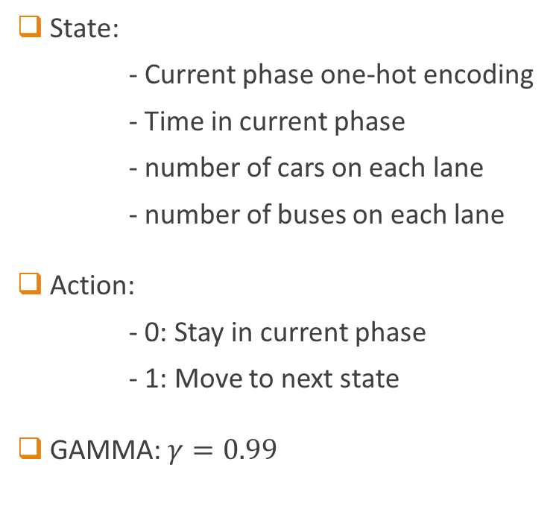
DQN - MDP definition
State:
- Current phase one-hot encoding
- Time in current phase
- number of cars on each lane
- number of buses on each lane
Action:
- 0: Stay in current phase
- 1: Move to next state
GAMMA: $γ=0.99$
Reward: we examine 2 rewards functions:
- Minus TTT (Total Travel Time)
- Minus Weighted TTT:
Car weight = x1 Bus weight = x15

Slide 9
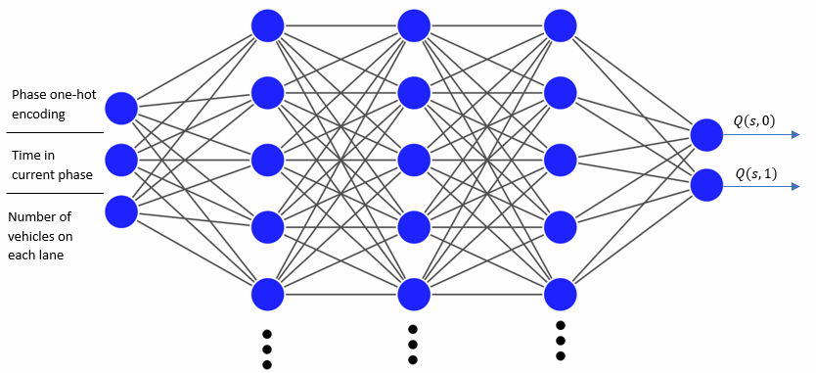
DQN
DQN leverages deep neural networks to estimate the Q function
Network Input: State Vector
Network Output: Q values of each action

Slide 10
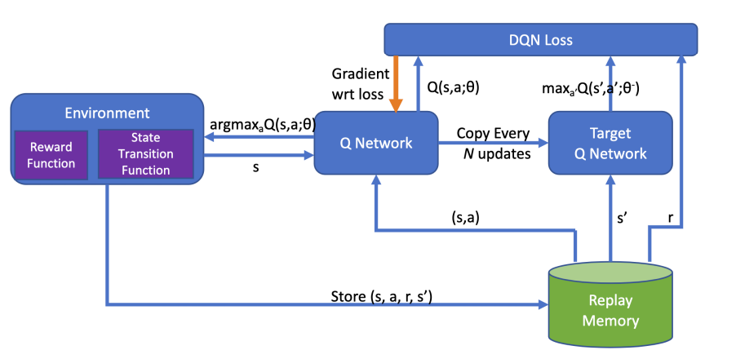
DQN - Training Process
Wang, Siyu, et al. "Auto-MAP: A DQN framework for exploring distributed execution plans for DNN workloads." arXiv preprint arXiv:2007.04069 (2020).

Slide 11
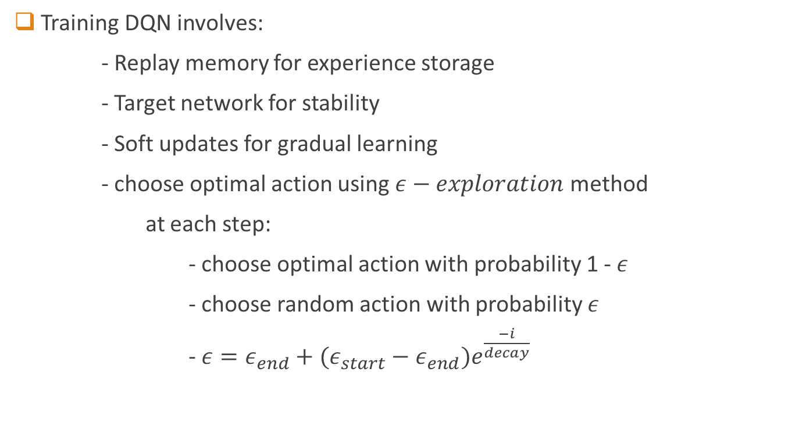
Training Process
Training DQN involves:
- Replay memory for experience storage
- Target network for stability
- Soft updates for gradual learning
- choose optimal action using $ε−exploration$ method
at each step:
- choose optimal action with probability 1 - $ε$
- choose random action with probability $ε$
- $ε=ε_{end}+(ε_{start}−ε_{end})e^{\frac{−i}{decay}}$

Slide 12
Simulation Environment
SUMO (Simulation of Urban MObility):
- create junction and traffic light system (TLS)
- create cars and buses flows
- provides ability to customize the environment
TRACI:
- API to communicate with SUMO
- Get data about junction status
- Control the TLS

Slide 13
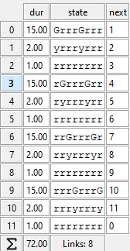
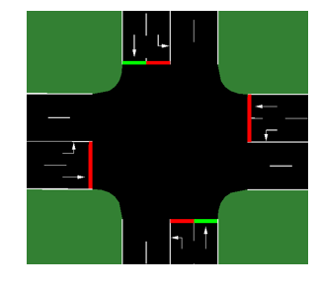
Simulation Setup
Traffic setup includes:
- Vehicle types: cars, buses
- Pre-defined traffic phases
Exponentially distributed intervals mimics real traffic flow.

Slide 14
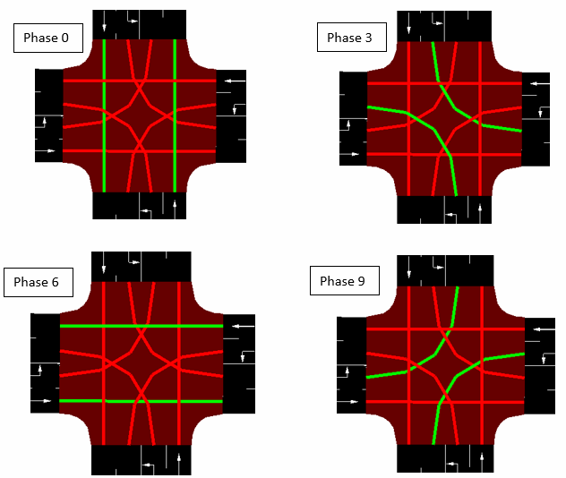
Simulation Setup

Slide 15
Simulation Setup
3 simulation types
Run each simulation 10 times (with different seeds) and train 10 models
Run 100-200 episodes to train each model
Run 3600 steps in each episode

Slide 16
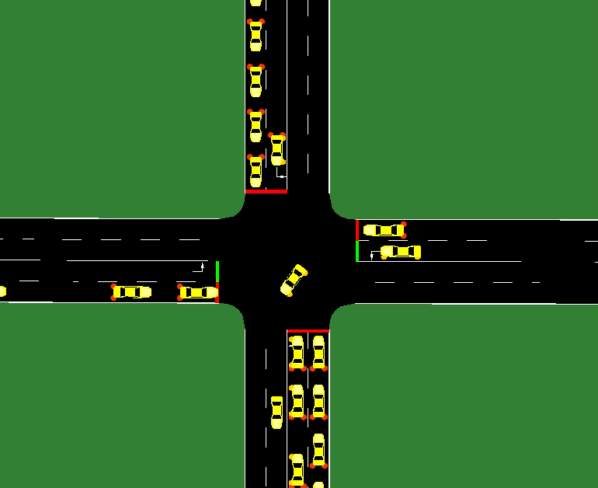
Simulation 1
low pressure
cars only - in each lane with interval: exp(0.07)
reward = minus TTT

Slide 17
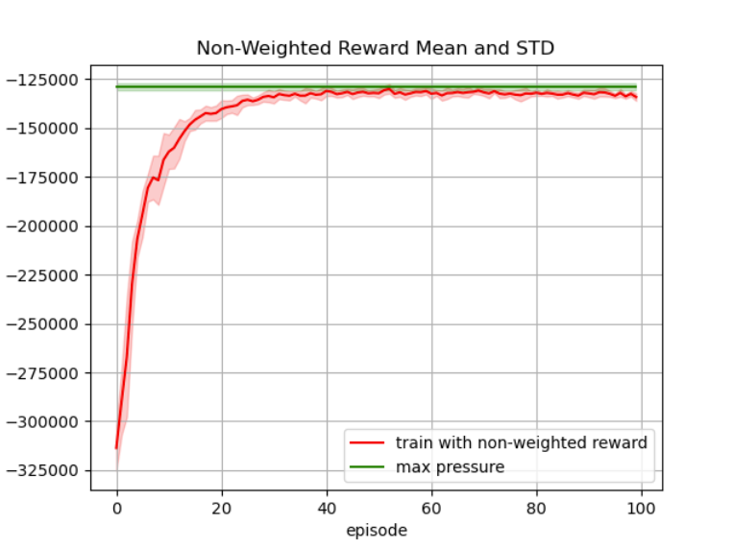
Results - Low Pressure

Slide 18
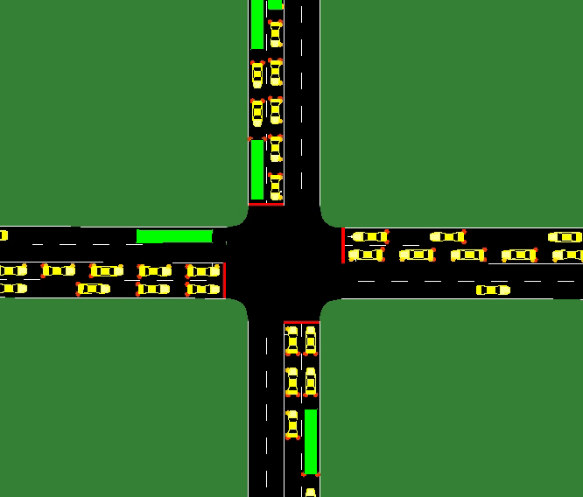
Simulation 2 + 3
high pressure
cars and buses - cars with intervals between exp(0.07) and exp(0.1) - buses with intervals between exp(0.01) and exp(0.03)
reward: - Sim2: minus TTT - Sim3: minus weighted TTT

Slide 19
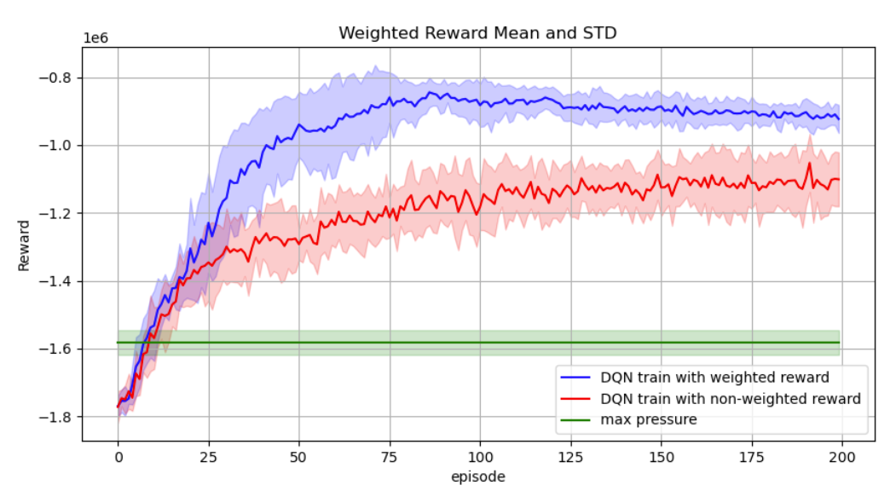
Results - High Pressure
Weighted Reward

Slide 20
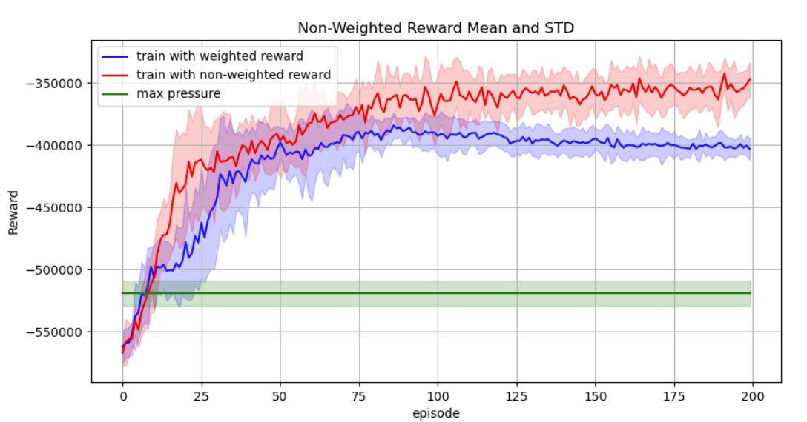
Results - High Pressure
Non-Weighted Reward

Slide 21
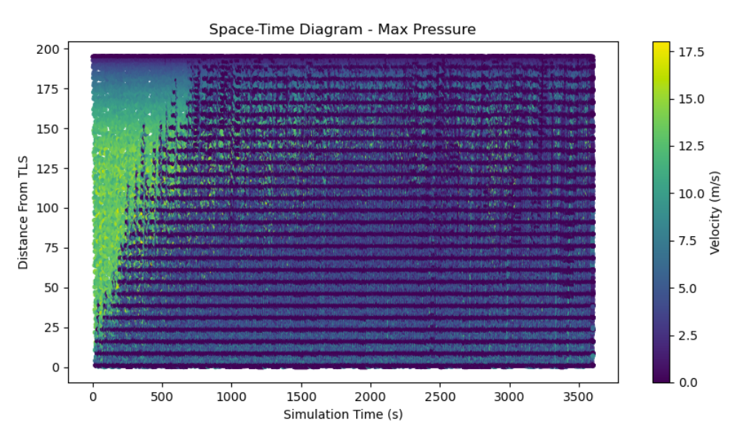
Results - High Pressure
Space-Time plot – Max Pressure

Slide 22
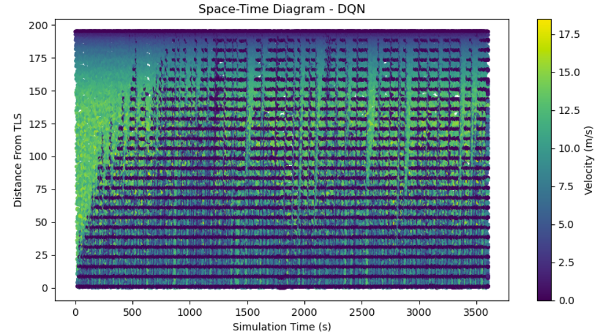
Results - High Pressure
Space-Time plot – DQN

Slide 23
Conclusion
Improvement Over Simple Methods
Successful Use of DQN in Traffic Control
Successful prioritization of public transportation
Feasible to implement for real life TLS

Slide 24
Future Work
Exploring multi-agent RL for larger networks
Experimenting with other RL methods like PPO, A3C …
Consider more advanced DQN variations like DDQN, Rainbow …

